Slide 1
Mission of Catholic Charities
The mission of Catholic Charities is to
provide service to people in need, to
advocate for justice in social structures,
and to call the entire church and
other people of good will to do the same.
Service • Advocacy • Convening
Notes:
Resources: Cadre Study
Captures the specific mission of local Catholic Charities agencies – many local agencies have some version of this woven into their statements

Slide 2
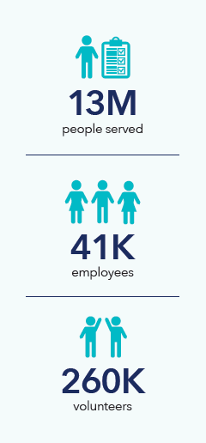
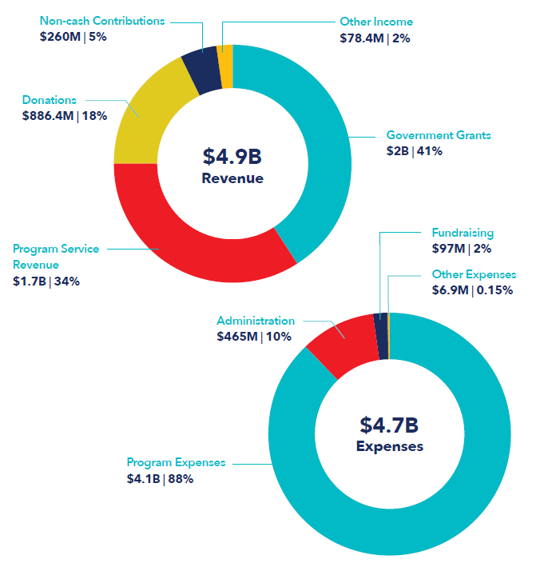
167 Member Agencies

Slide 3

CCUSA Priorities
Notes:
INCLUDE HISTORY of CCUSA 110th Anniversary 1910-2020

Slide 4
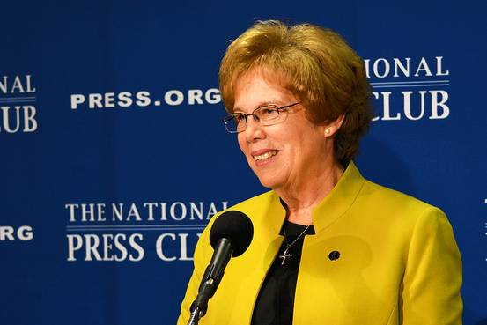
Recent COVID Relief Efforts
Catholic Charities agencies collectively spent about $100M a month just in food and basic needs assistance in COVID-19 relief ministries.
CCUSA distributed monies to Catholic Charities Agencies obtained from many foundations (e.g. Robert Wood Johnson Foundation) and donors for food, PPE, outreach and health related efforts.
Created the CCUSA-Felician Sisters and Ministries Eviction Prevention Fund.
Working in close collaboration with the USDA Farmers to Families Program.
Sister Donna Markham, OP, PhD
President & CEO
Catholic Charities USA

Slide 5
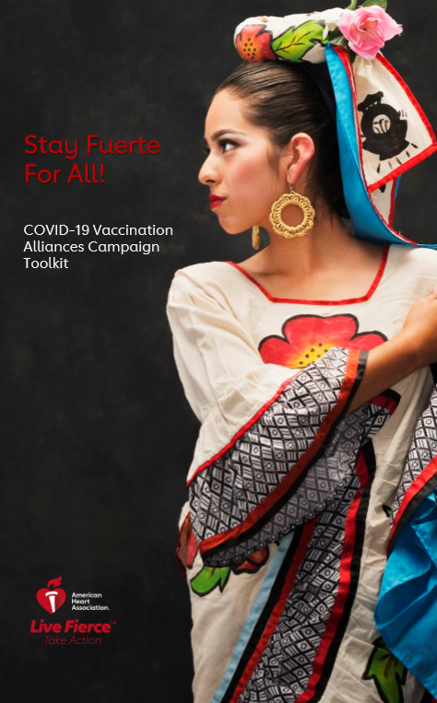

Slide 6
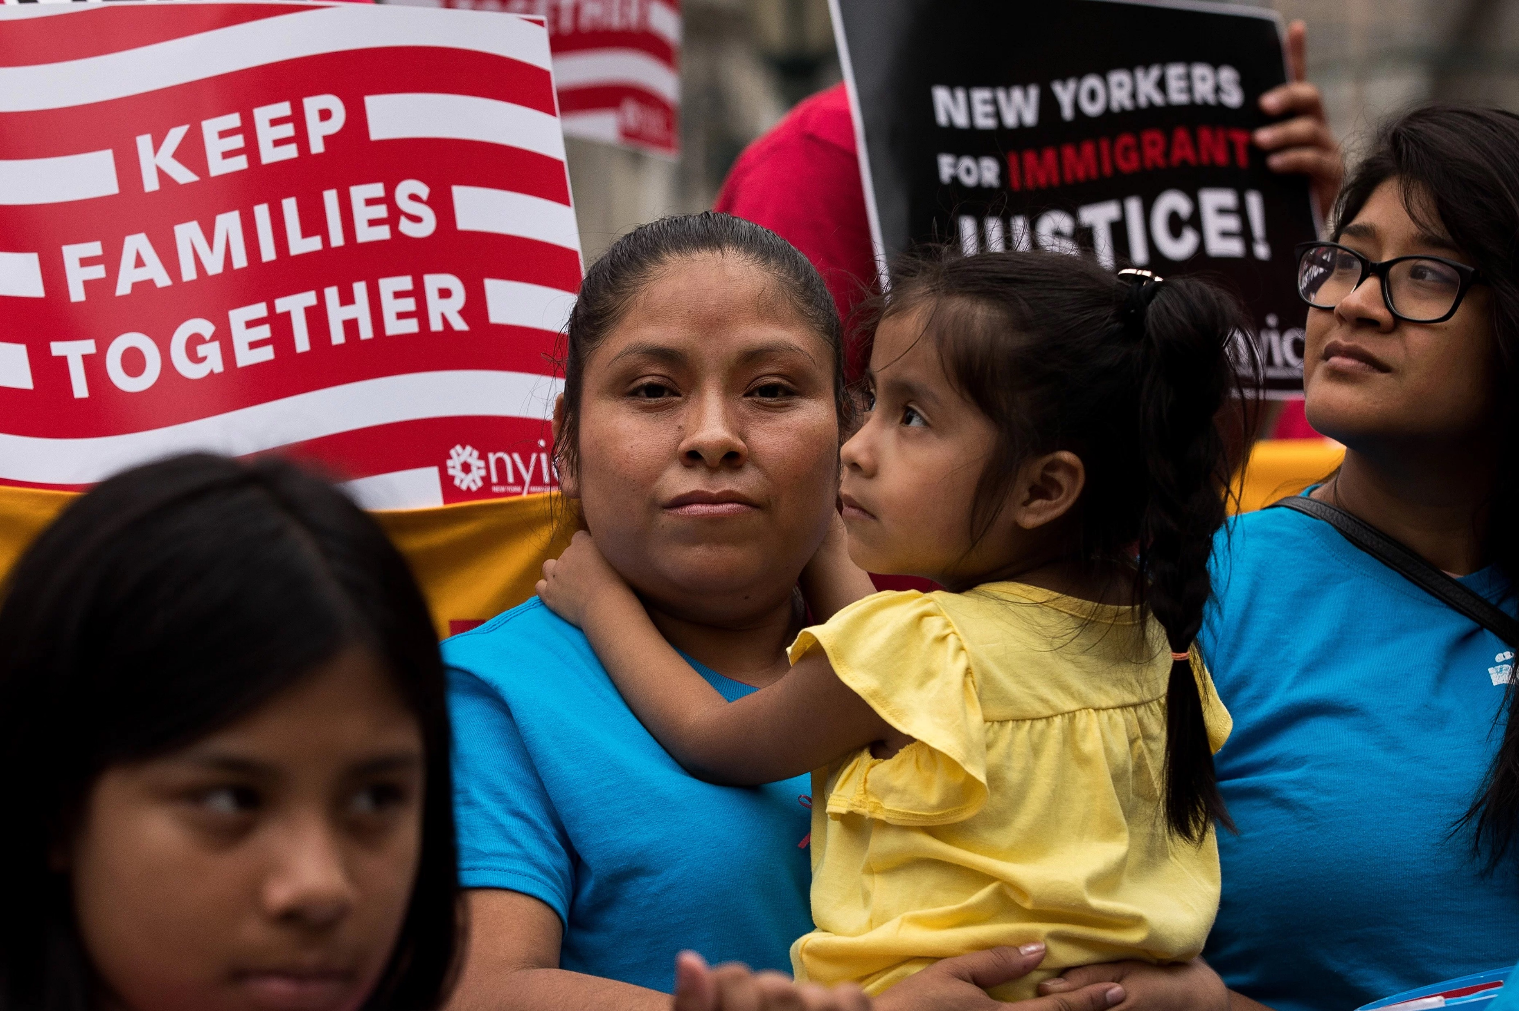
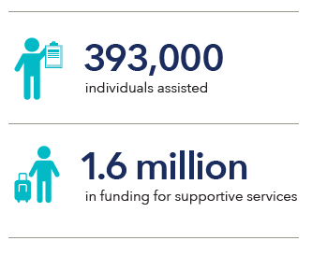
Immigrant & Refugee Services
Legal advice & counseling
Citizenship applications
Family Visa Petitions
Legal representation
ICE Raid Response
ESL & Interpreter services
Employment training & job placement
Unaccompanied refugee minors
Family reunification

Slide 7
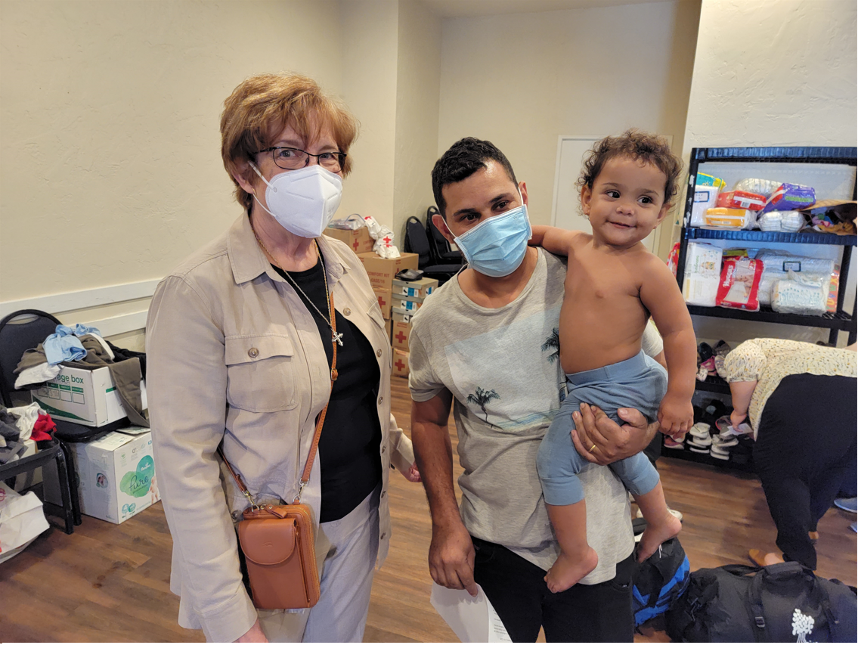
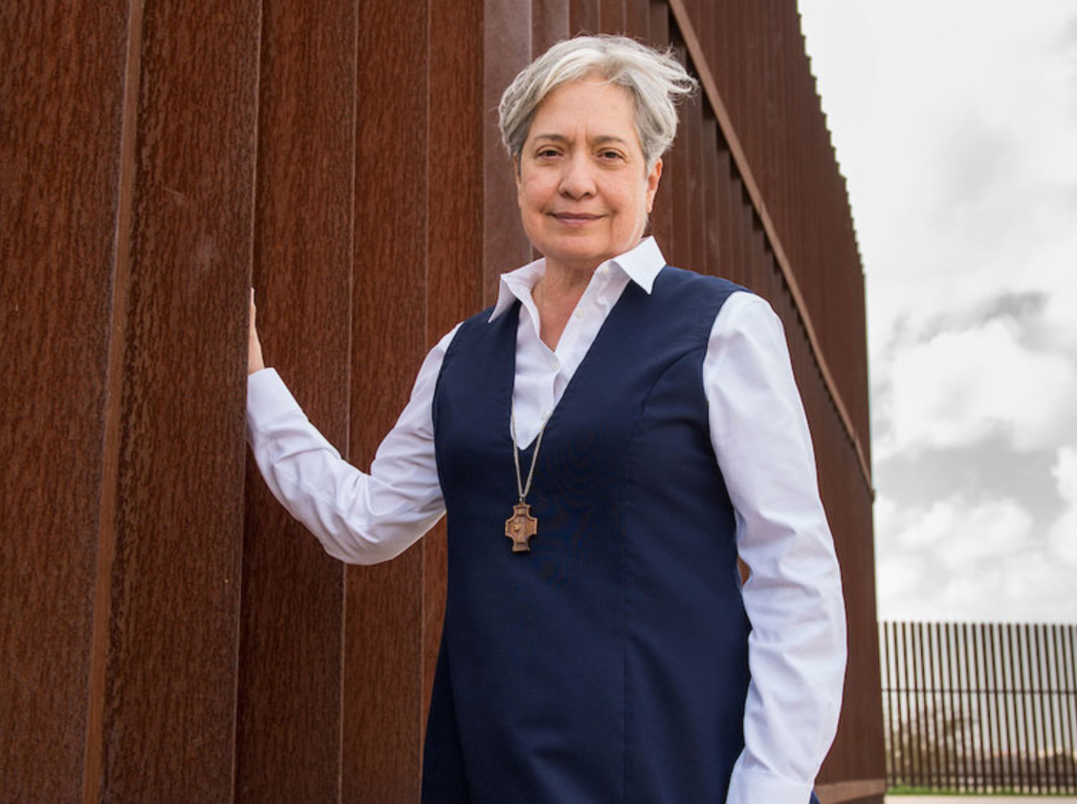
Sister Norma Pimentel, M.J.
Executive Director
Catholic Charities of the Rio Grande Valley
Sister Donna Markham, OP
President and CEO
Catholic Charities USA

Slide 8
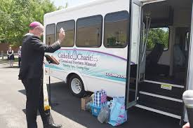
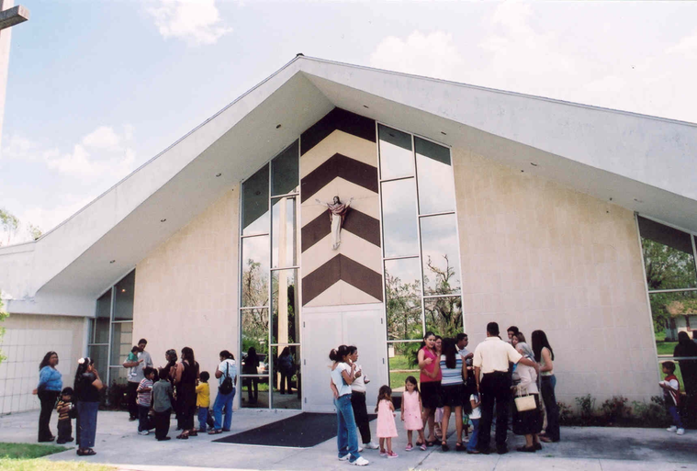
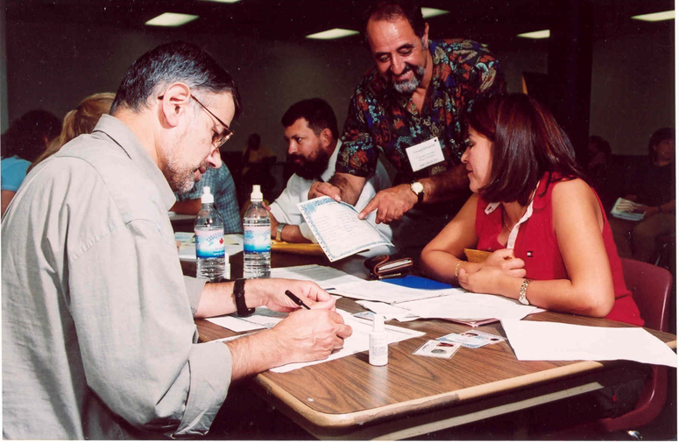
Parish Social Ministry
PSM programs build up the parish’s capacity to live out the Church’s mission to care for the poor and to work for justice.

Slide 9
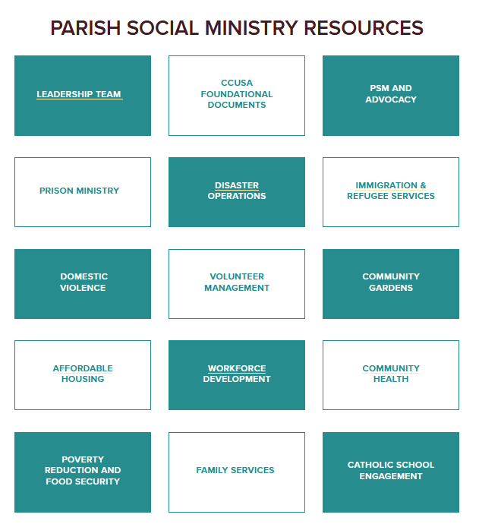
www.catholiccharitiesusa.org

Slide 10
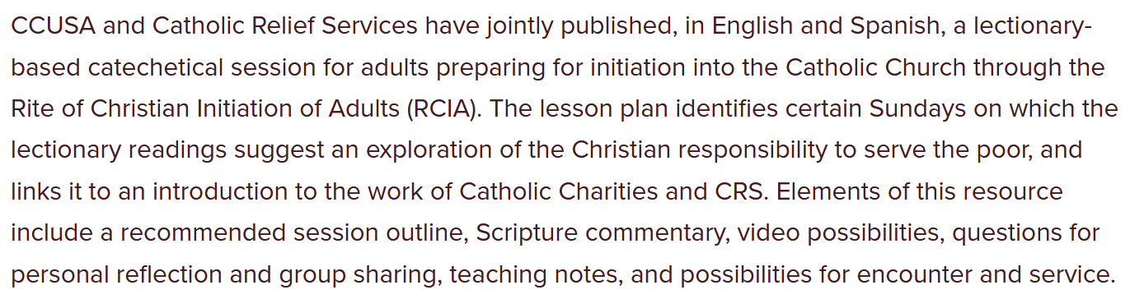
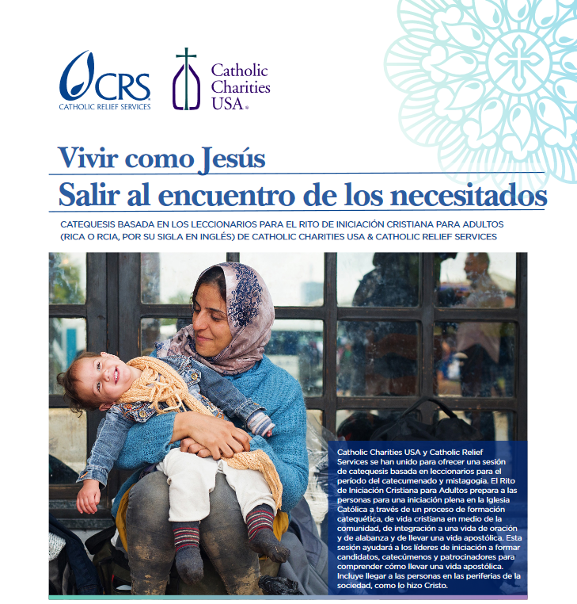
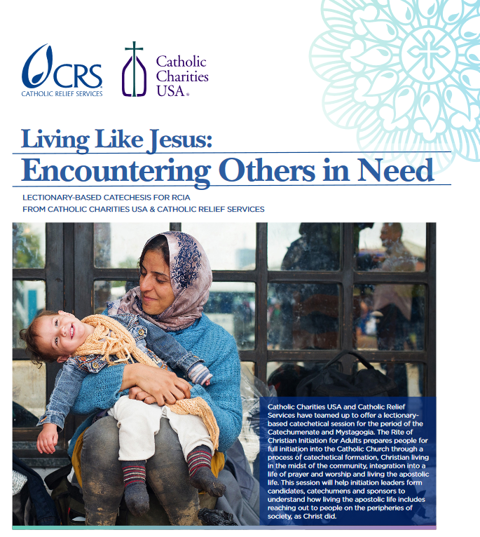

Slide 11
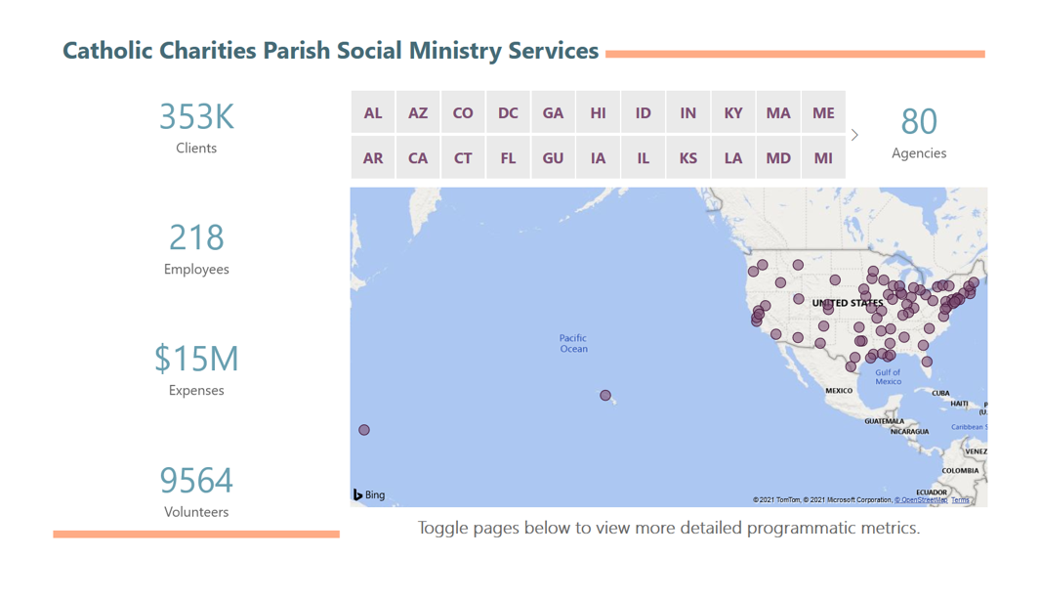

Slide 12
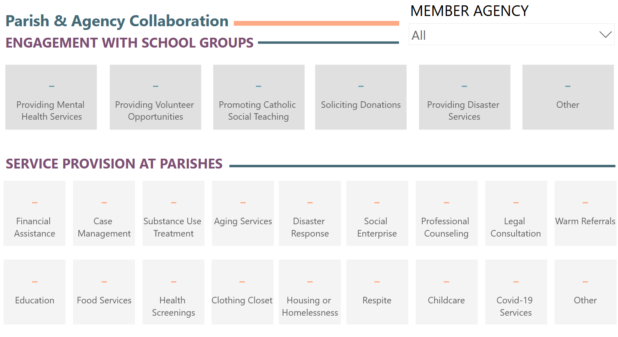

Slide 13
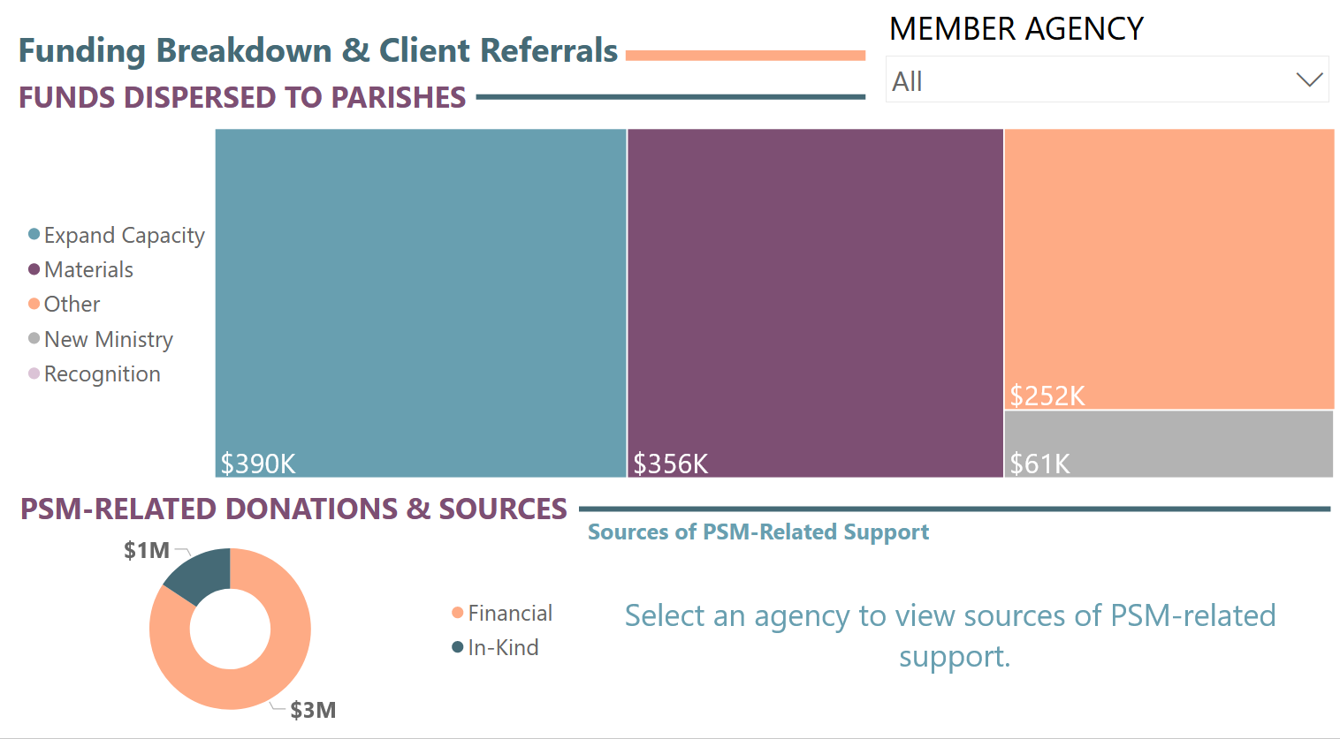

Slide 14
For a Synodal Church:
Communion, Participation, and Mission
“…it will be of fundamental importance that the voice of the poor and excluded also find a place…”

